Slide 1
Quick tutorial on using www.wix.com
By Evelien Schilder

Slide 2
1) Sign up

Slide 3
2) Create your own site
1) Click on ‘Create’
2) Choose a template

Slide 4
3) Editing your template
Just click on any part you would like to edit
Just explore
[Click here for video]

Slide 5
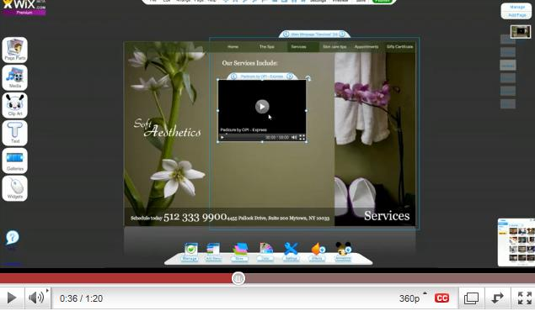
How to: Add videos? Menu bars? Anything?
Over a 100 tutorials are available on: http://www.youtube.com/user/wixmypage
How to add a video?
How to add menu bars?
[Click here for video]
[Click here for video]

Slide 6
4) Done? Publish your website
Click on publish
Save your address

