Slide 1
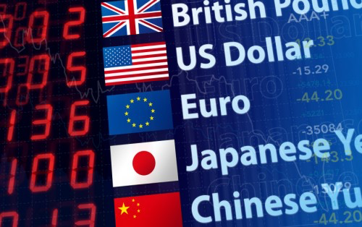
International Monetary Systems
Topic: Trade Balances and Basics of Exchange Rates

Slide 2
Contact Information and website
Dr. Dave McEvoy
Associate Professor of Economics
Appalachian State University, NC 28608
Email: mcevoydm@appstate.edu
Course Website: davemcevoy.weebly.com/imsangers2018.html

Slide 3
Group Work: Trade and trade restrictions
Ecoland is a small country that produces and consumes jelly beans.
The world price of jelly beans (outside of Ecoland) is €1 per bag.
Ecoland’s domestic demand and supply functions for jelly beans are:
Q^{D} = 8 – P
Q^{S} = P
where P and Q are prices in euros and quantity in bags.

Slide 4
Q^{D} = 8 – P
Q^{S} = P
P^{W} = €1 per bag
Answer the following (drawing graphs will help!!):
No trade: Calculate the equilibrium price (the domestic price), quantity, consumer surplus, producer surplus and total surplus.
Free Trade: Calculate the equilibrium price (the domestic price) quantity produced domestically, quantity consumed domestically, imports, consumer surplus, producer surplus and total surplus
Trade with Tariff: Suppose a €1 tariff is imposed for all inputs. Calculate equilibrium price (domestic price), quantity produced domestically, quantity consumed domestically, imports, consumer surplus, producer surplus, government revenue and total surplus.
What are the gains from free trade in Euros? What is the deadweight loss from the trade restriction?

Slide 6
Countries with highest overall tariffs
Iran (28%)
Bhutan (27.7%)
Sri Lanka (17.6%)
Nepal (16.8%)
Pakistan (16.6%)
Zimbabwe (14.6%)
Cameroon (14.6%)
Chad (14.3%)
Barbados (14.2%)
Sierra Leone (13.8%)

Slide 7
Some examples of trade agreements over time
After the Great Depression of the early 1930s countries imposed high tariffs, import quotas and foreign-exchange controls.
After World War II the General Agreement on Tariffs and Trade (GATT) was negotiated → now enforced by the World Trade Organization (WTO).
“the substantial reduction of tariffs and other trade barriers and the elimination of preferences on a reciprocal and mutually advantageous basis” – purpose of GATT (1947)
WTO established in 1995 and 153 countries have joined. The functions of the WTO are to administer trade agreements, provide a forum for negotiations and handle disputes.

Slide 8
Trade agreements over time (some examples)
European Economic Community (1957, Treaty of Rome) → European Community → European Union
NAFTA – North American Free Trade Agreement (1993)
CAFTA – Central America Free Trade Agreement (2004)

Slide 9
Accounting for Trade: Balance of Payments
The balance of payments is a measurement of all transactions between domestic and foreign residents over a specified period of time.
The transactions are presented in three groups – a current account, a financial account and a capital account.

Slide 10
Current Account (CA)
Summary of the flow of funds due to purchases of goods or services, flows of income from financial assets and transfers.
Trade Balance: Value of Exports – Imports of goods and services
Net Factor Income: Inflows – Outflows of income (interest and dividend payments) on financial assets (securities)
Net Unilateral Transfers: Aid/Transfers/Gifts Received – those Given

Slide 11
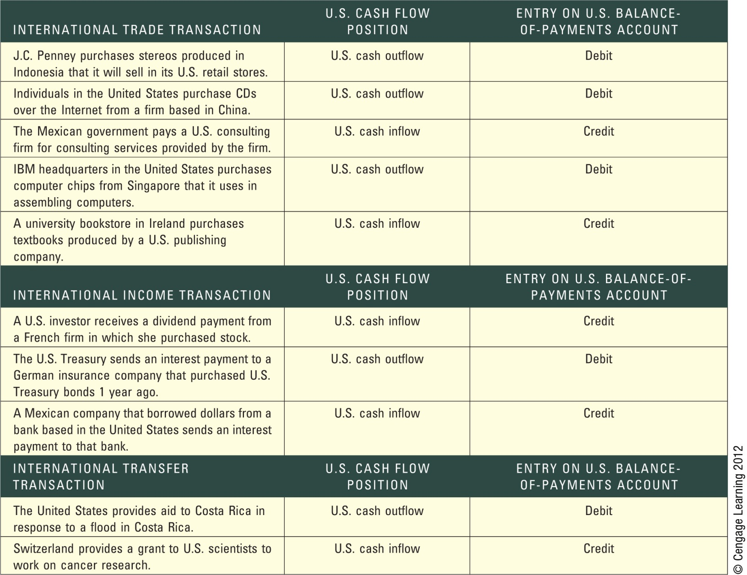

Slide 12
Current Account Examples (French perspective)
Where do each of these transactions get recorded?
French citizens earning dividends from U.S. stock
French citizens buy computers from Japan online
Bank of France pays an interest payment to investment held by a German company
Peugeot buys parts from a Swedish manufacturer
French government sends financial aid to Haiti after hurricane

Slide 13
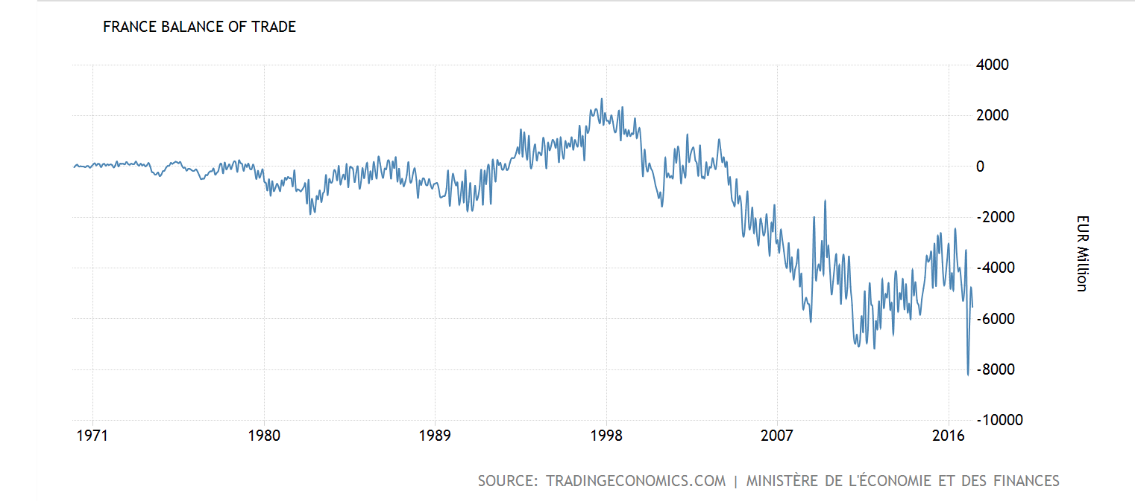

Slide 14
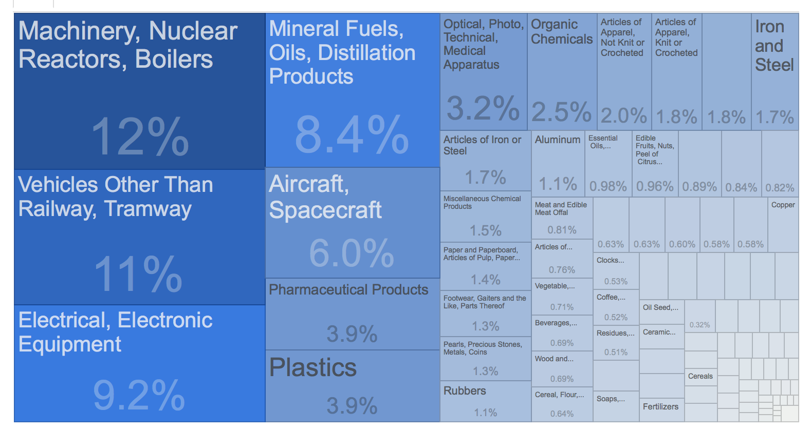
France – Imports (2016)

Slide 15
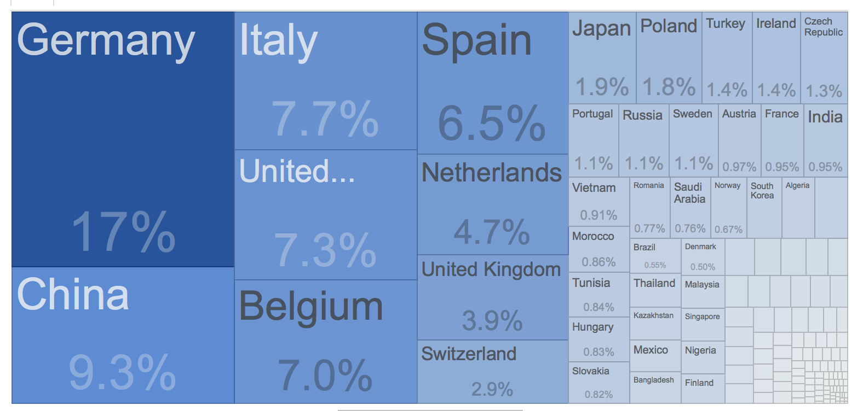
France – Imports (2016) – by country

Slide 16
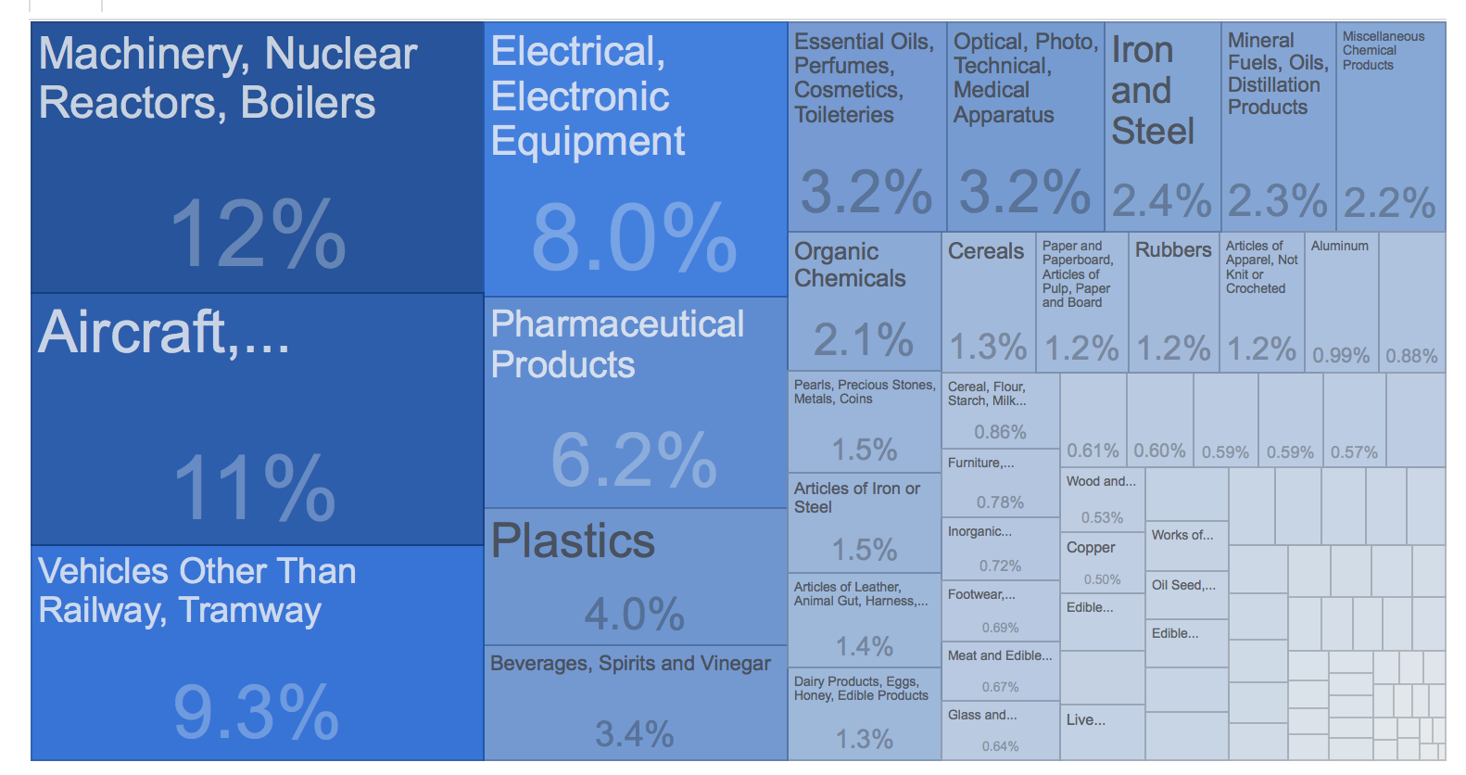
France – Exports (2016)

Slide 17
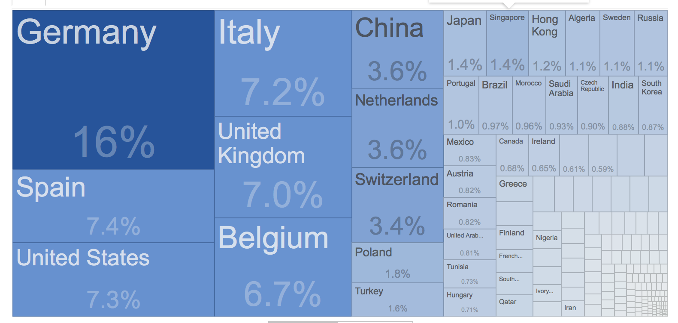
France – Exports (2016)

Slide 18
Since 2004, France has been recording trade deficits due the gradual erosion of manufactured exports, the appreciation of the EUR and the increasing dependency on imports of fuel (was once as high as 17 percent of total imports).

Slide 19
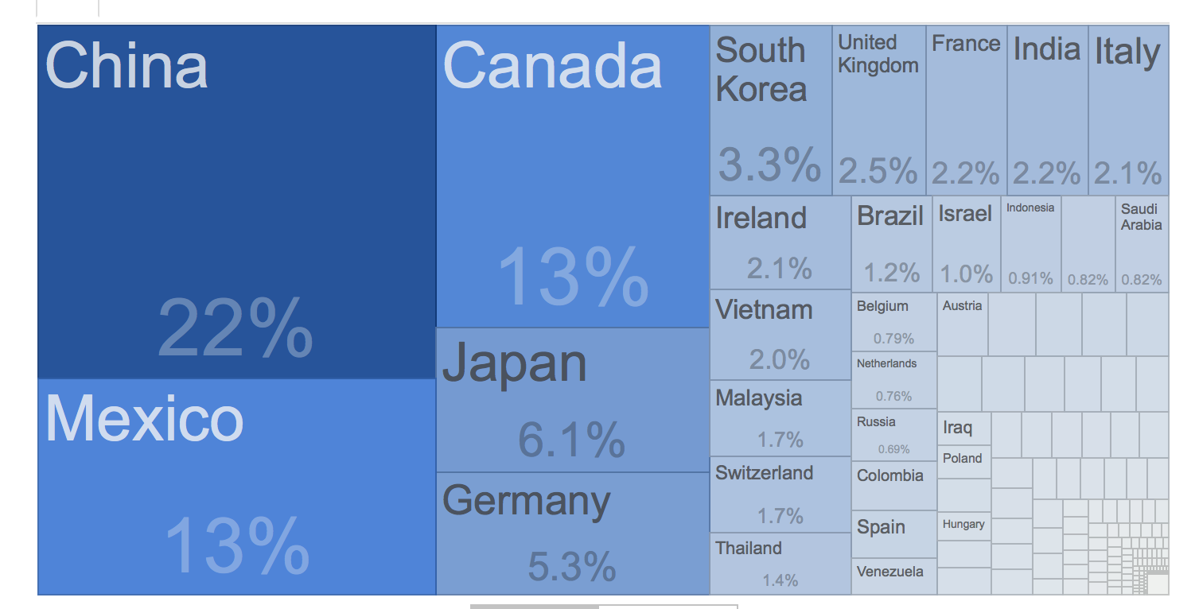
US – Imports (2016)

Slide 20
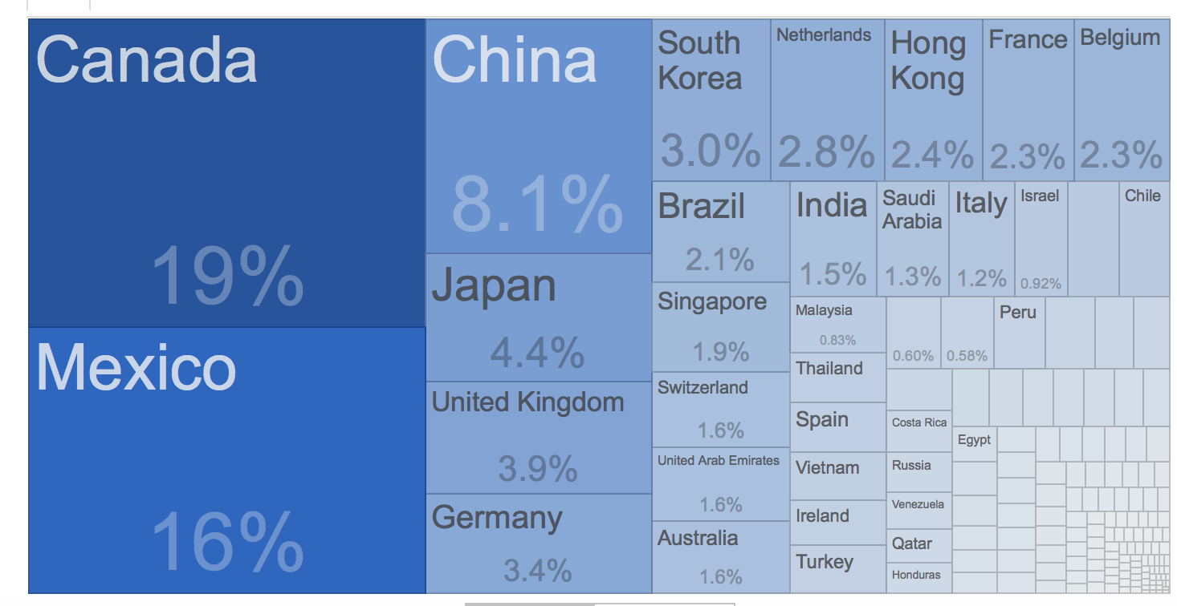
US –Exports (2016)

Slide 21
Financial Account
Sales of assets to foreigners (+) -- purchases of assets located abroad (-) (e.g. purchasing a residence abroad)
Foreign Direct Investment (FDI)
Government held reserves of foreign currencies

Slide 22
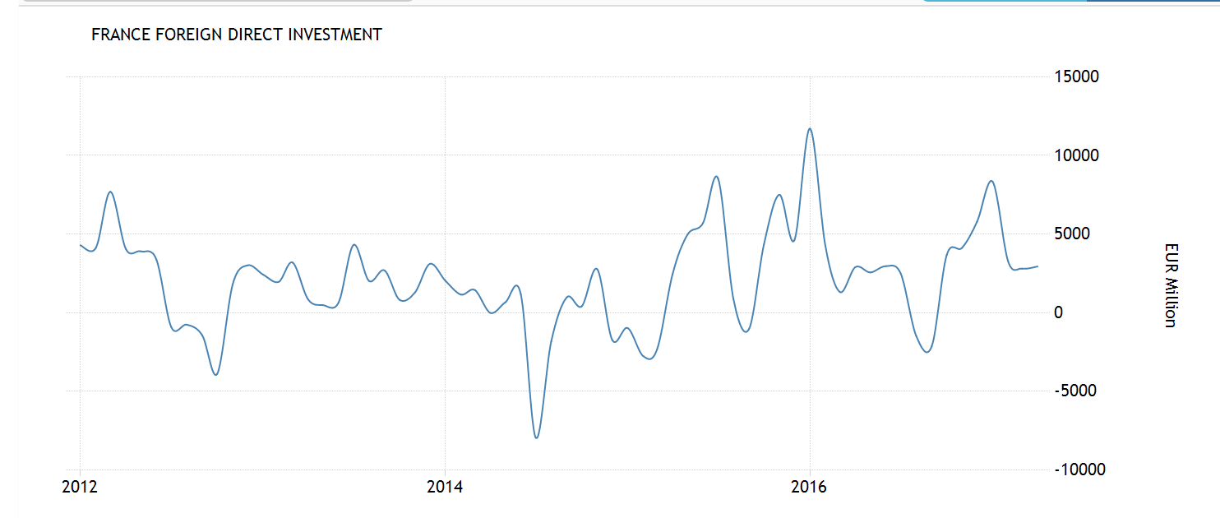
FDI Balance – France (most recent 5 years)

Slide 23
Capital Account
These include non-produced, non-financial exchange of assets between countries.
Purchasing a foreign trademark
Purchasing drilling rights from another country
Charity gifts
Debt forgiveness

Slide 24
Facilitating trade between countries: Currencies and exchange rates

Slide 25
Basics of exchange
Home currency and foreign currency
“units of home currency needed to buy 1 unit of foreign currency”
E€/$ = number of euros needed to buy 1 U.S. dollar. --
“European Terms”
1/E€/$ = E$/€ = number of U.S. dollars needed to buy 1 euro –
“American Terms”
Suppose at current time E€/$ = 0.89 (E$/€ = 1.12)

Slide 26
Basics of exchange
Suppose at current time E€/$ = 0.89
Question: If euro-dollar exchange rate drops from 0.89 to 0.80 is the euro appreciating (getting stronger) or depreciating (getting weaker) against the dollar?
Answer: The euro is getting stronger against the dollar. It takes fewer euros to buy 1 U.S. dollar. Of course, it must be the case that it takes more dollars to buy 1 euro.
US terms is $1.25 per euro.

Slide 27
Some intuition
Suppose the price of a liter of gasoline was 4€ per liter.
If the price drops to 3€ per liter, then euros appreciated against gasoline. It takes fewer euros to buy one liter of petrol.

Slide 28
Calculating percentage changes
Suppose at current time E€/$ = 0.89
Question: If euro-dollar exchange rate drops from 0.89 to 0.80 what is the percentage change (appreciation or depreciation) in the euro-dollar exchange rate? In other words, what is the % change in “European Terms”?
Change = (End – Start)/Start
Change = (0.80 – 0.89)/0.89 = -0.10
Answer: The euro appreciated against the dollar by 10%.

Slide 29
Calculating percentage changes
Suppose at current time E€/$ = 0.89
If euro-dollar exchange rate drops from 0.89 to 0.80.
Question: How much did the dollar appreciate or depreciate by?
“American Terms”?
Change = (End – Start)/Start
Change = (1.25 – 1.12)/1.12 = 0.1161
Answer: The dollar depreciated against the euro by 11.61%

Slide 30
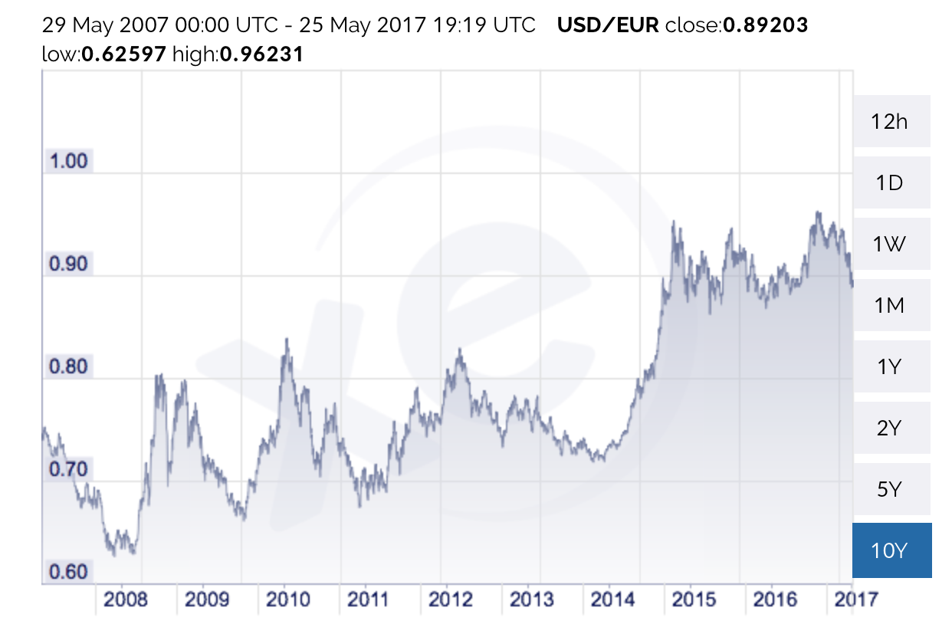
Euros needed to buy 1 U.S. dollar = E€/$
€
Period B
Period A

Slide 31
Group Work: Questions on the graph
In which period was the euro stronger against the dollar?
In early 2014 the euro-dollar exchange rate was 0.74. In late 2014 it was 0.94. What was the percentage change? 27% depreciation in the euro.
In which period do you think the Trade Balance (Exports – Imports with Europe) would be higher for the United States? Why?
In Period A, when the euro is strong, European countries are going to import relatively more from the U.S. Goods and services are relatively cheap in the US so better to import. For the US, it is the opposite. The US export market will increase when the dollar weakens.

Slide 32
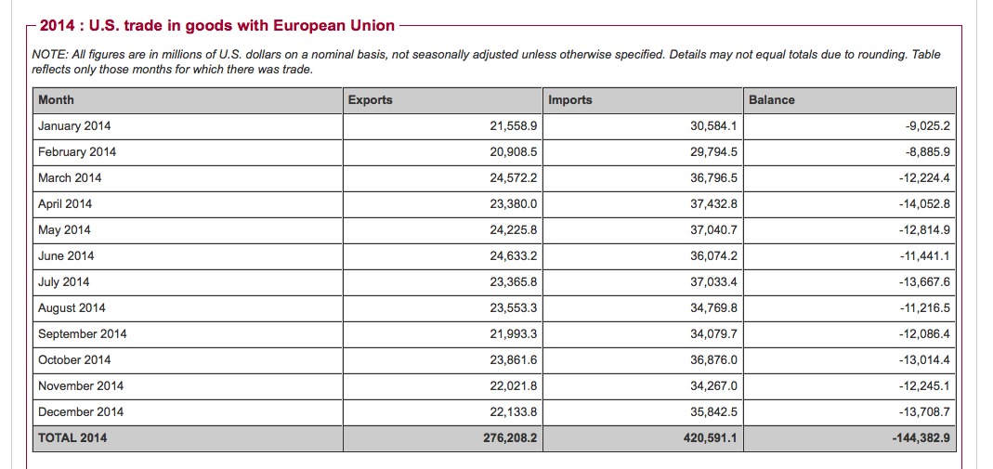

Slide 33
Group work: Shopping around
Consider your home country France. You want to buy a specific computer, and you want to spend the least amount of euros.
You can purchase the computer in France (euros), Japan (yen) or the U.S. (dollar). Suppose no transactions costs (i.e., no cost to convert)
The yen-dollar exchange rate = E¥/$= 112 and the yen-euro exchange rate = E¥/€= 125
From the prices provided below, in which country is the computer sold for the lowest price? (in euros)
Price | Price in €
180,000 yen | 1,440 euros
1,500 euros | 1,500 euros
1,800 dollars | 1,613 euros

Slide 34
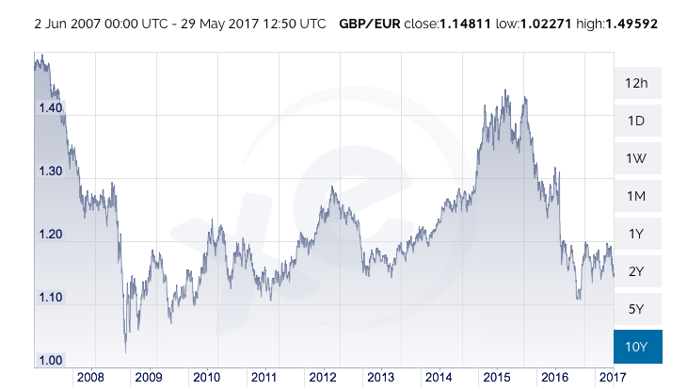
Euros needed to buy 1 British pound = E€/£
What might help explain this decrease?

Slide 35
Market for foreign exchange (Forex or FX)
So far the exchange rates we have looked at are called “spot” exchange rates. They happen “on the spot”. Right now.
For many countries those rates are determined by international currency markets. The Forex Market is where currencies are bought and sold. In 2014 trading averaged 4.8 trillion ($) per day in the Forex market.
Most Forex activity is done by major commercial banks in the financial centers of the world
90% of Forex transactions are spot exchanges.
The other 10% of derivatives (rates derived from the spot exchange rate)

Slide 36
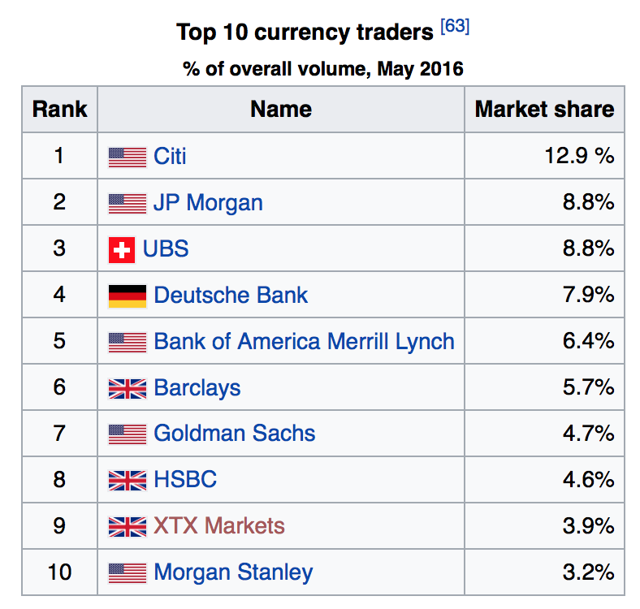

Slide 37
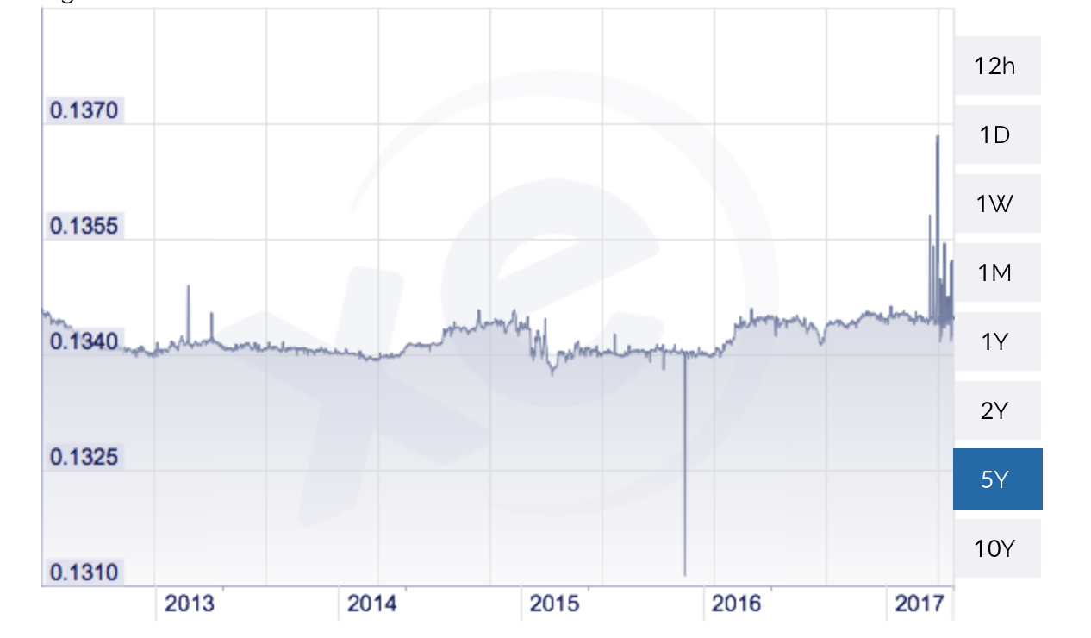
Fixed vs. floating – some exchange rates are fixed or pegged and only fluctuate marginally. Here is an example of a pegged exchange rate E_{€/DKr}

Slide 38
Government involvement in Forex
Capital controls – a restriction on cross-border financial transactions
Intervention – typically through central bank. Holding reserves of foreign currencies and buying and selling to influence exchange rates

Slide 39
Derivatives
Forwards: Two parties make a contract today, but the settlement date for the transaction is in the future. 30 days, 90 days, six months, one year. (typically the Forward rate follows spot rate very closely)

Slide 40
Derivatives
Forwards: Two parties make a contract today, but the settlement date for the transaction is in the future. 30 days, 90 days, six months, one year. (typically the Forward rate follows spot rate very closely)
Swaps: Two parties make a transaction today at the spot rate and simultaneously contract a future reverse transaction at a fixed time in the future at forward rate (reduces risk and transactions costs)

Slide 41
Derivatives
Forwards: Two parties make a contract today, but the settlement date for the transaction is in the future. 30 days, 90 days, six months, one year. (typically the Forward rate follows spot rate very closely)
Swaps: Two parties make a transaction today at the spot rate and simultaneously contract a future reverse transaction at a fixed time in the future at forward rate (reduces risk and transactions costs)
Futures: Just like the Forward contract except the contracts are standardized, mature at certain regular dates and can be traded on an organized futures market. So the same parties that made the deal do not necessarily need to be involved at the time of close.

Slide 42
Derivatives
Forwards: Two parties make a contract today, but the settlement date for the transaction is in the future. 30 days, 90 days, six months, one year. (typically the Forward rate follows spot rate very closely)
Swaps: Two parties make a transaction today at the spot rate and simultaneously contract a future reverse transaction at a fixed time in the future at forward rate (reduces risk and transactions costs)
Futures: Just like the Forward contract except the contracts are standardized, mature at certain regular dates and can be traded on an organized futures market. So the same parties that made the deal do not necessarily need to be involved at the time of close.
Options: The buyer of an option has the right to purchase (a call) or sell ( a put) a currency in exchange for another at a specified rate at a future date. The seller of the option must perform the trade if the buyer wants, however, the buyer has no obligation to trade.

Slide 43
Example: Hedging
You are a US Firm and you expect to receive a payment of 1 million euros from France in 90 days for exported goods.
The current spot rate is $1.20 per euro. Your firm will incur losses on the deal if the exchange rate drops below $1.10 per euro.
How can the US Firm use an OPTION to avoid some potential losses?

