Slide 1
Paul Meehl & Trans-situationality
Hull had an independent predictor of Rewards
Primary Needs produce Drives → Reward
But Harlow showed that approach did NOT work
The Law of Effect has become “Circular”
If you get an effect then it is a reward
If you don’t get an effect then it is NOT a reward
There is no independent predictor of an event being a reward
We need an independent predictor

Slide 2
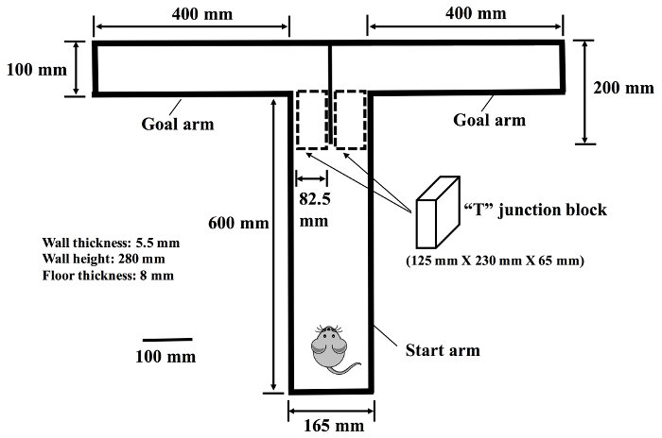
A smart Martian visits Earth and finds a T-maze

Slide 3
Trans-situational Law of Effect
Two Types of Responses
Controlled by the Law of Effect
NOT controlled by the Law of Effect
Two Types of Consequences (the event that follows the response)
Events that will work as Reward/Reinforcer
Events that will NOT work as Reward/Reinforcer
Principle of Trans-situationality
Law of Effect works but must know…
Type of Response – controlled by Law of Effect?
Type of Consequence – is it a Reward?
You can then predict which rewards work with which responses

Slide 4
Idealized application of Trans-Situational approach
The Goal is to use a Reward to change a specific Behavior
Question 1: Has this behavior been changed in the past by a reward in other situations?
Question 2: Is there a verified reward available to be used in this situation?
The approach generates lists of responses and rewards that can be used trans-situationally.

Slide 5
Meehl’s Basic Conclusions
Law of Effect works.
There exist certain events that have a “special property” that controls whether a behavior will be repeated.
That “special property” is unidentified at the moment.
But once we identify an event as having that special property then we can predict the effect of that event in other situations.

